Slide 1
Basic Electrical and Electronics Engineering
LECTURE 1.9
Dr. Sonam Shrivastava/ Assistant Professor (Sr.) /SELECT

Slide 2
BEEE102L
Basic Electrical and Electronics Engineering
DC Circuits
AC Circuits
Magnetic Circuits
Electrical Machines
Semiconductor Devices and Applications
Digital Systems
Sensors and Transducers

Slide 3
Books
Text Books
Allan R. Hambley, “Electrical Engineering -Principles & Applications”, 2019, 6th Edition, Pearson Education
V. D. Toro, Electrical Engineering Fundamentals, 2nd edition. PHI, 2014
Reference Books
R. L. Boylestad and L. Nashelsky, Electronic Devices and Circuit Theory, 11th edition. Pearson, 2012
DP Kothari & Nagrath, “Basic Electric Engineering”, 2019, Tata McGraw Hill

Slide 4
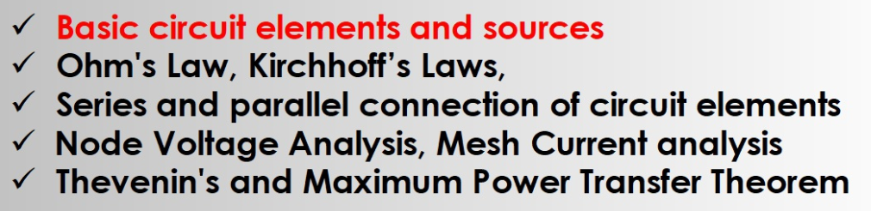
Module I. DC Circuits
Source transformation
Super position theorem
STAR- DELTA Transformation

Slide 5
STAR –DELTA TRANSFORMATION
Introduction
Star Connection
Delta Connection
Delta to Star Transformation
Star to Delta Transformation
Equivalent Resistance of Circuit
Exercise/Numerical Analysis 2

Slide 6
STAR –DELTA TRANSFORMATION
STAR/Delta transformations and equivalent circuit calculations help in simplification and understanding of complex electrical circuits.
Star/Delta connection is an arrangement of passive elements R, L and C such that the formed shape resembles a star or a delta symbol. ➢ These connection are neither series and nor parallel. ➢ Such connections are simplified using star-to-delta or delta-to-star conversion. ➢ Such connections are found in complex DC circuits, full bridge rectifiers. ➢ Such connections has larger application in three phase AC system.

Slide 7
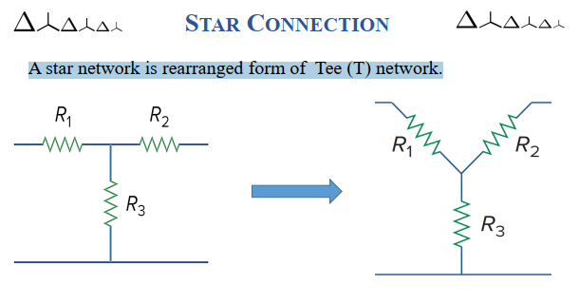

Slide 8
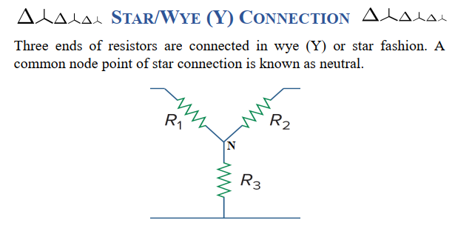

Slide 9
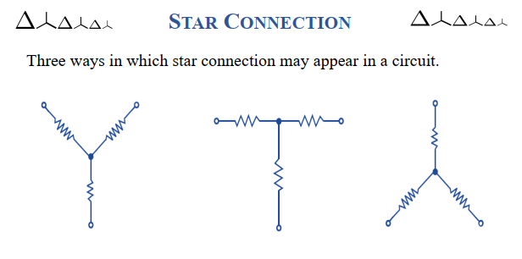

Slide 10
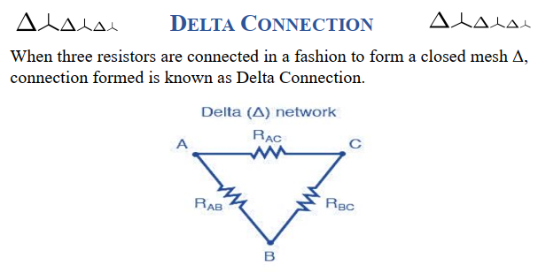

Slide 11
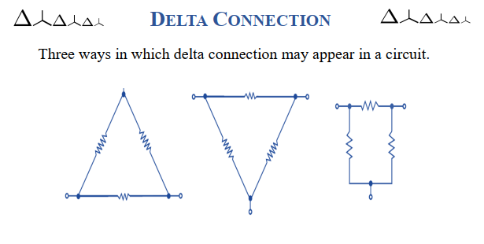

Slide 12
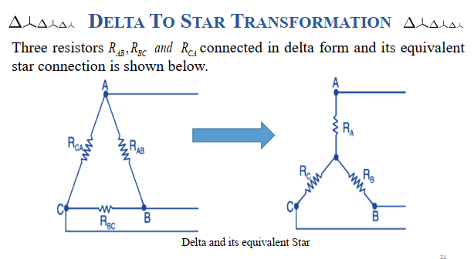

Slide 13
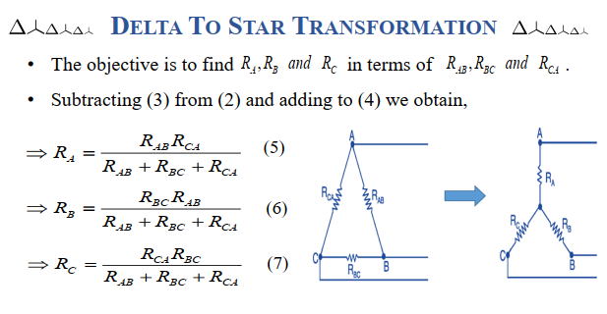

Slide 14
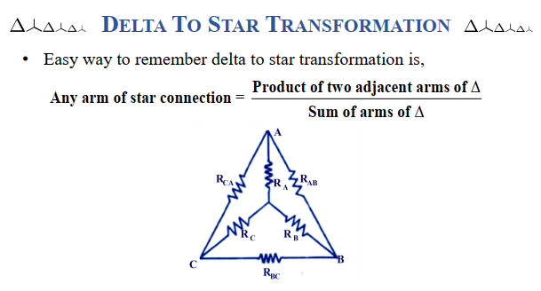

Slide 15
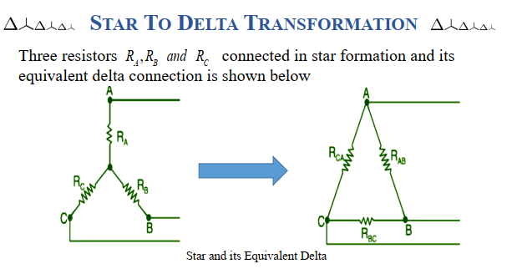

Slide 16
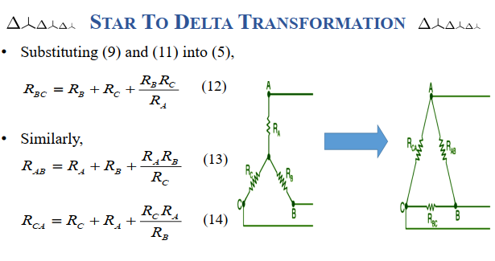



$$R_{CA}=\frac{R_{A}R_{B}+R_{B}R_{C}+R_{C}R_{A}}{R_{B}}$$
$$R_{AB}=\frac{R_{A}R_{B}+R_{B}R_{C}+R_{C}R_{A}}{R_{C}}$$
$$R_{BC}=\frac{R_{A}R_{B}+R_{B}R_{C}+R_{C}R_{A}}{R_{A}}$$

Slide 17
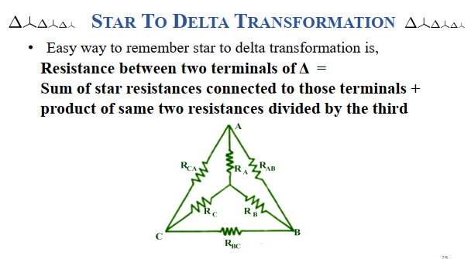

Slide 18
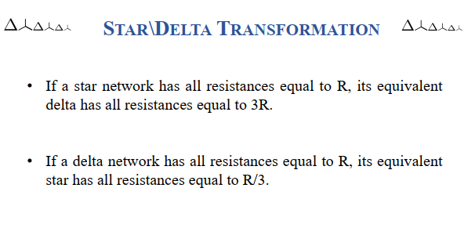

Slide 19
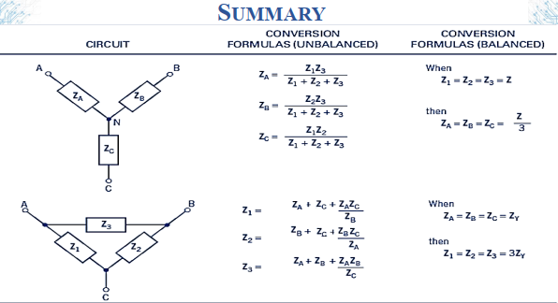

Slide 20
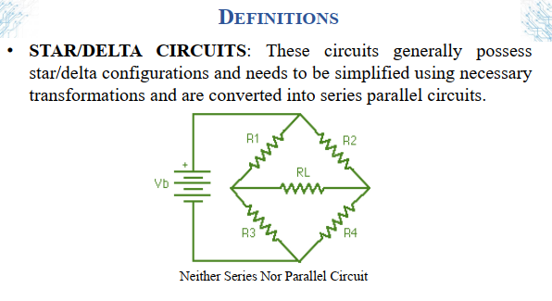

Slide 21
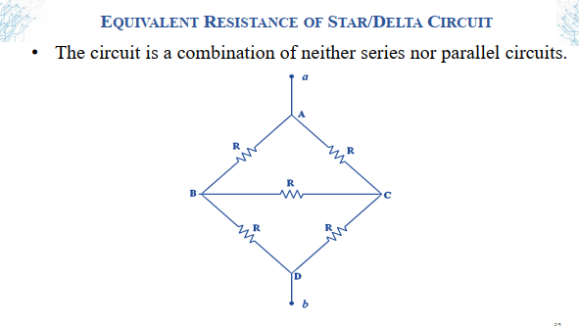

Slide 22
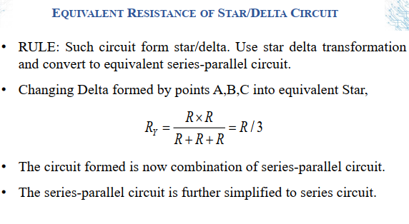

Slide 23
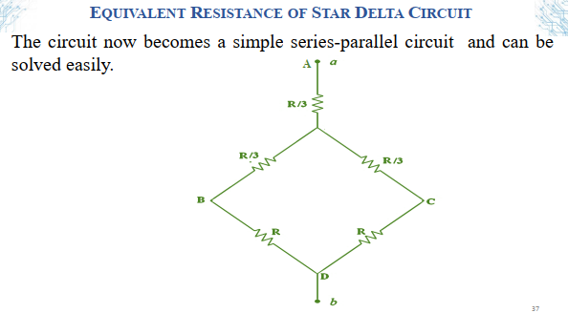

Slide 24
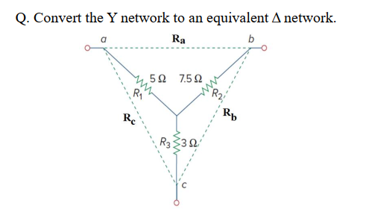

Slide 25
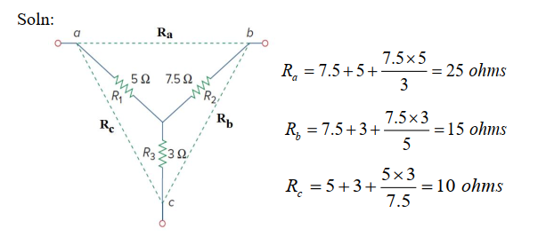

Slide 26
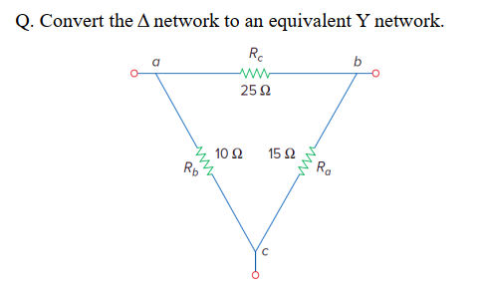

Slide 27
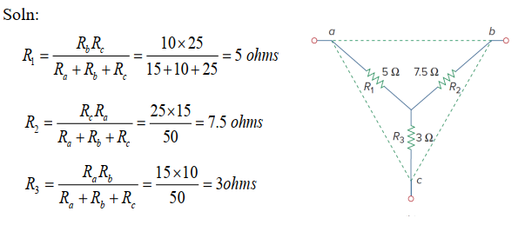

Slide 28
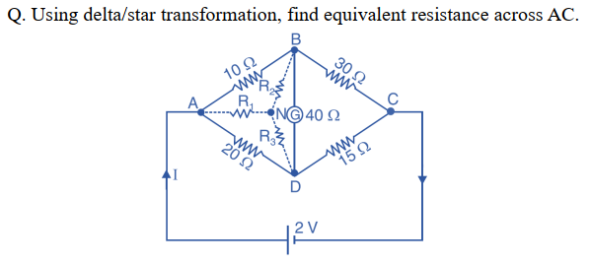

Slide 29
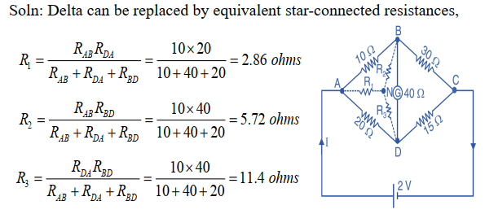

Slide 30
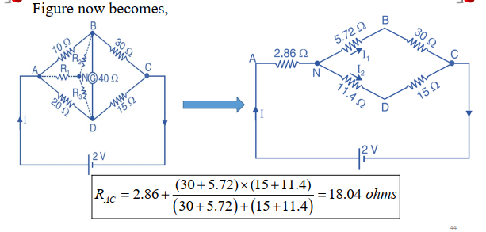

Slide 31
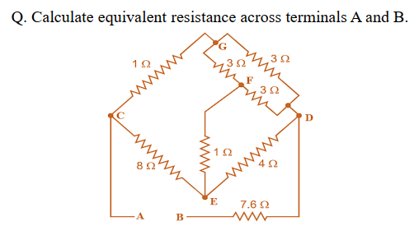

Slide 32
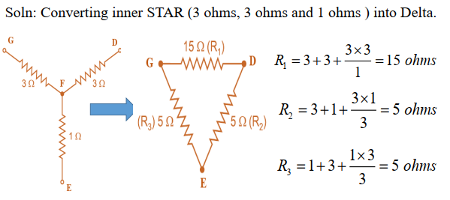

Slide 33
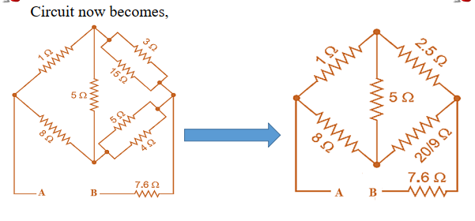

Slide 34
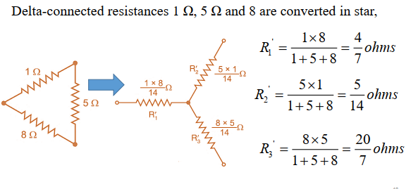

Slide 35
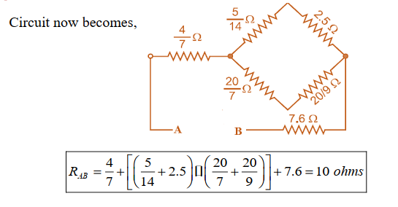

Slide 36
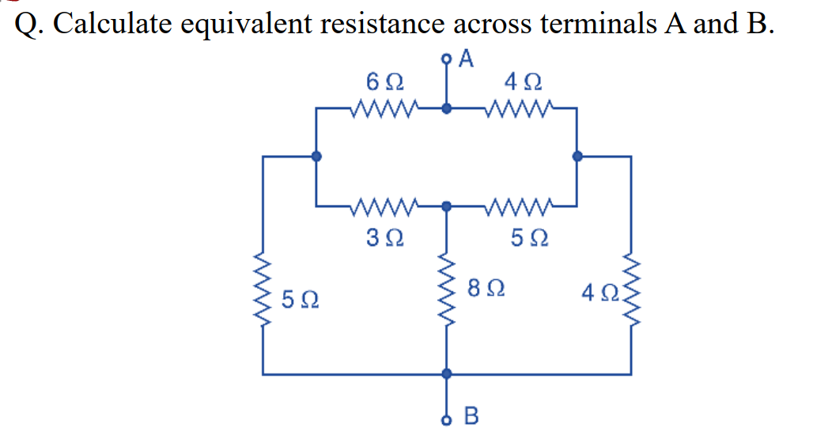

Slide 37
4.23 Ohms

Slide 38
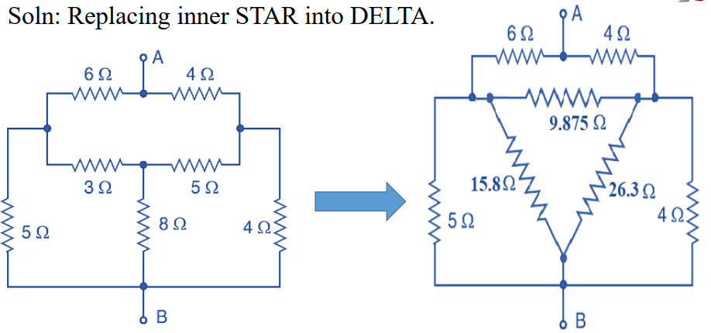

Slide 39
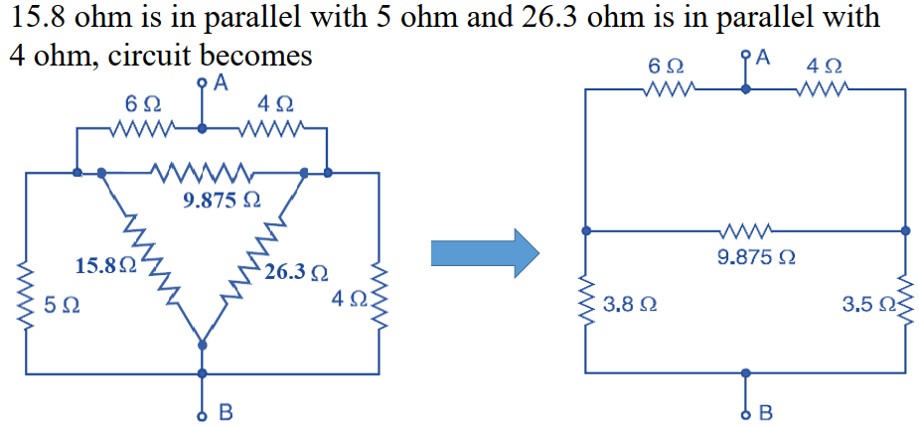

Slide 40
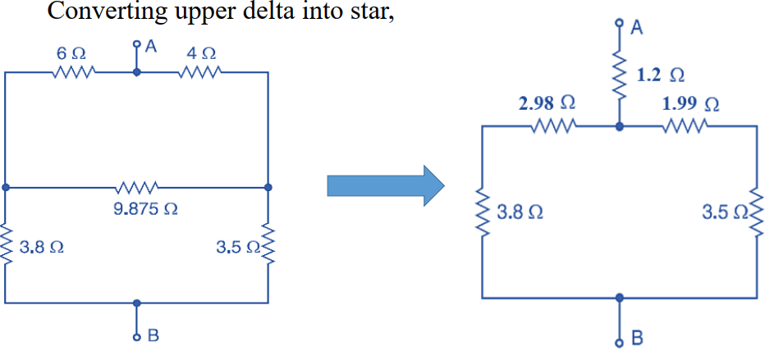

Slide 41
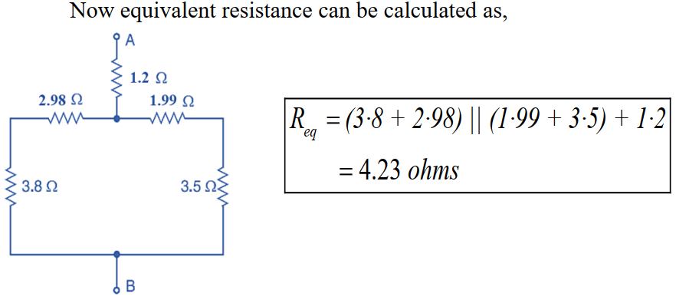

Slide 42
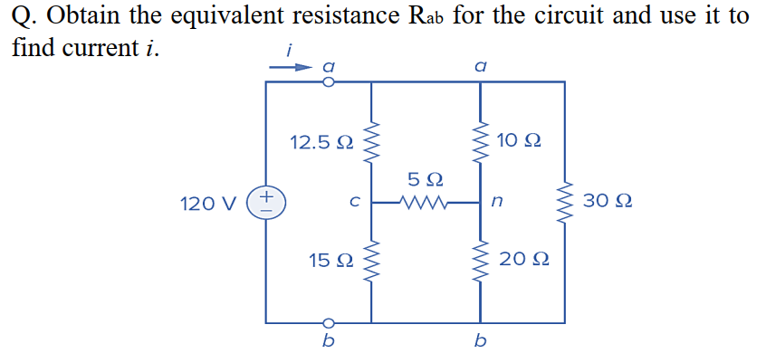

Slide 43
Hint: Convert the Y-network comprising the 5-Ω, 10-Ω, and 20-Ω resistors into delta
12.458 A

Slide 44
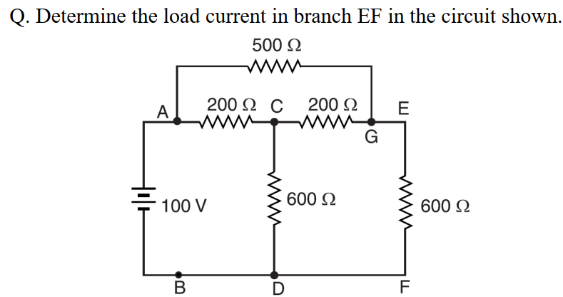

Slide 45
Convert this delta to star
0.1055 A

Slide 46
Thank you

